Slide 1
CS 528 - DEMO 2
Stop Wasting the Cloud
Mentors:
Dan Macpherson
Patrick Dillion
Team Members:
Anshu Goel
Jhukhirtha Marhi Arokiasamy
Sahil Gupta
Sidharth Bakshi
Vedant Mahabaleshwarkar
Notes:
aks

Slide 2
Recap (Sprint 1)
Vision: Utilize slack resource in each node to run BOINC jobs
Sprint 1: We had already containerized BOINC based CentOS image in our local machines.
Sprint 2 Goal: Deploy the image on MOC as Daemonset and research how it scales and interacts with other pods

Slide 3
What is Daemonset??
A DaemonSet is a controller in Kubernetes which ensures that all (or some) Nodes run a copy of a Pod
As nodes are added to the cluster, Pods are added to them. As nodes are removed from the cluster, those Pods are garbage collected.
Deleting a DaemonSet will clean up the Pods it created.
Some typical uses of a DaemonSet are:
Running a cluster storage daemon, such as glusterd, ceph, on each node.
Running a logs collection daemon on every node, such as fluentd or logstash.
Running a node monitoring daemon on every node, such as Prometheus Node Exporter, collectd, Dynatrace OneAgent, AppDynamics Agent, Datadog agent, New Relic agent, Ganglia gmond or Instana agent.

Slide 4
Alternative Approach
An alternative approach to using DaemonSets would be to queue the containers having the BOINC application with the lowest priority in the Kubernetes scheduler.
Comparison between two approaches:
The alternative approach will provide a generic solution to the problem but this comes with a downside of hampering user experience as they will have to do a lot of configuration in order to use our architecture
Kubernetes might schedule multiple BOINC pods in the same nodes while our aim is to schedule these pods in every nodes which is what daemonset does
Alternative approach will add extra workload to scheduler and nodes in case the pods are not efficiently spread across all nodes while daemonset will add extra workload on nodes only when kubernetes tries to kill the pods

Slide 5
Handling credentials
Kubernetes secret objects let you store and manage sensitive information, such as passwords, OAuth tokens, and ssh keys.
We have used secret objects to pass World Community Grid URL and Account key

Slide 6
Tuning BOINC preferences
What are BOINC User Preferences?
Computing preferences that determine when and how BOINC uses your computer. Computing preferences mainly are: CPU Usage Limits, When to suspend, Day-of-the-week limits, Disk, Network Usage Limits, suspension and Day-of-the-week limits and Memory.
Can be easily manipulated and changed using a GUI called BOINC Manager on your Personal Computer
BOINC Client (Host)
Sends Host Hardware availability information and request for Work Units
BOINC Project Server
Sends list of Work Units along with Default User Preferences set by the Project
HTTP response and request using XML
Notes:
https://boinc.berkeley.edu/wiki/Preferences#List_of_computing_preferences
Usage limits
Use at most N % of the CPUs: Keeps some CPUs free for other applications. Example: 75% means use 6 cores on an 8-core CPU.
Use at most N % CPU time: Suspend/resume computing every few seconds to reduce CPU temperature and energy usage. Example: 75% means compute for 3 seconds, wait for 1 second, and repeat.
When to suspend
Suspend when computer is on battery: Check this to suspend computing when running on battery power.
Suspend when computer is in use: Check this to suspend computing and file transfers when you're using the computer.
Suspend GPU computing when computer is in use: Check this to suspend GPU computing when you're using the computer.
'In use' means mouse/keyboard input in last N minutes: This determines when the computer is considered 'in use'.
Suspend when non-BOINC CPU usage is above N %: Suspend computing when your computer is busy running other programs.
Compute only between HH:MM and HH:MM: Specify time-of-day range.
Other
Store at least N days of work: Store at least enough tasks to keep the computer busy for this long.
Store up to an additional N days of work: Store additional tasks above the minimum level. Determines how much work is requested when contacting a project.
Switch between tasks every N minutes: If you run several projects, BOINC may switch between them this often.
Request tasks to checkpoint at most every N seconds: This controls how often tasks save their state to disk, so they can be restarted later.
Day-of-the-week limits
Specify day-of-the-week time ranges when BOINC can compute.
Disk
Use no more than N GB: Limit the total amount of disk space used by BOINC.
Leave at least N GB free: Limit disk usage to leave this much free space on the volume where BOINC stores data.
Use no more than N% of total: Limit the percentage of disk space used by BOINC on the volume where BOINC stores data.
Memory
When computer is in use, use at most N %: Limit the memory used by BOINC when you're using the computer.
When computer is not in use, use at most N%: Limit the memory used by BOINC when you're not using the computer.
Leave non-GPU tasks in memory while suspended: If checked, suspended tasks stay in memory, and resume with no work lost. If unchecked, suspended tasks are removed from memory, and resume from their last checkpoint.
Page/swap file: use at most N %: Limit the swap space (page file) used by BOINC.
Network
Usage limits
Limit download rate to N KB/second: Limit the download rate of file transfers.
Limit upload rate to N KB/second: Limit the upload rate of file transfers.
Limit usage to X MB every Y days: Example: BOINC should transfer at most 2000 MB of data every 30 days.
When to suspend
Specify a range of times during which BOINC can transfer files.
Other
Skip data verification for image files: Check this ONLY if your Internet provider modifies image files (UMTS does this, for example). Skipping verification reduces the security of BOINC.
Confirm before connecting to Internet: Useful only if you have a modem, ISDN or VPN connection.
Disconnect when done: Useful only if you have a modem, ISDN or VPN connection.
Day-of-week limits
Specify day-of-the-week time ranges when BOINC can transfer files.

Slide 7
Tuning BOINC Preferences
Why are we tuning BOINC User Preferences?
Tune BOINC to efficiently consume resources of the nodes on Openshift cluster
How are we tuning BOINC User Preferences?
Customize Preferences by storing the new Preferences in new XML elements
We created a 'preferences override file' in BOINC data directory. This file is read by the core client after it reads the preferences from the server, and it overrides those preferences. The preferences override file is named global_prefs_override.xml
This configuration file global_prefs_override.xml for the BOINC core client can be used to override global preferences locally.

Slide 8
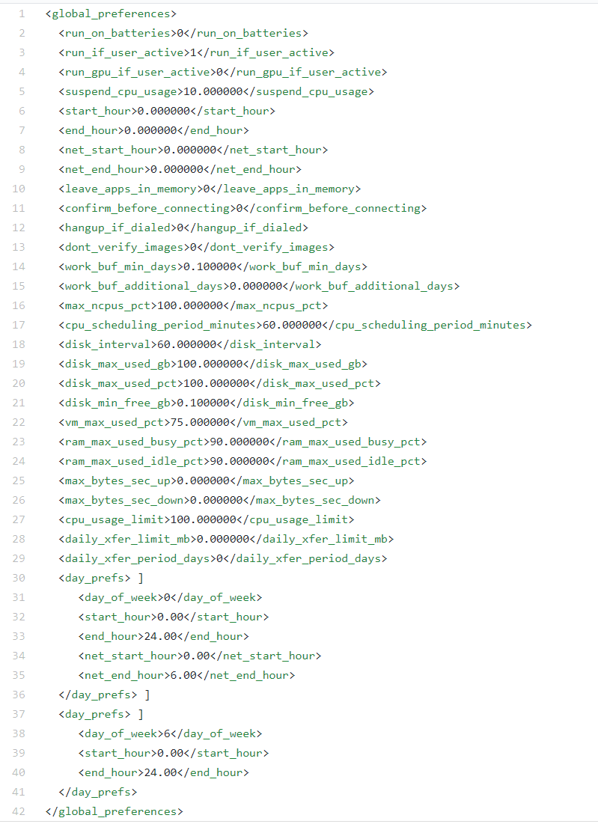
Tuning BOINC Preferences
Notes:
<global_preferences> [ <host_venue>X</host_venue> ] <run_on_batteries/> <run_if_user_active/> <suspend_if_no_recent_input>%f</suspend_if_no_recent_input> <start_hour>%f</start_hour> <end_hour>%f</end_hour> <net_start_hour>%f</net_start_hour> <net_end_hour>%f</net_end_hour> <leave_apps_in_memory/> <confirm_before_connecting/> <hangup_if_dialed/> <dont_verify_images/> <work_buf_min_days>%f</work_buf_min_days> <work_buf_additional_days>%f</work_buf_additional_days> <max_cpus>%d</max_cpus> <cpu_scheduling_period_minutes>%f</cpu_scheduling_period_minutes> <disk_interval>%f</disk_interval> <disk_max_used_gb>%f</disk_max_used_gb> <disk_max_used_pct>%f</disk_max_used_pct> <disk_min_free_gb>%f</disk_min_free_gb> <vm_max_used_pct>%f</vm_max_used_pct> <ram_max_used_busy_pct>%f</ram_max_used_busy_pct> <ram_max_used_idle_pct>%f</ram_max_used_idle_pct> <idle_time_to_run>%f</idle_time_to_run> <max_bytes_sec_up>%f</max_bytes_sec_up> <max_bytes_sec_down>%f</max_bytes_sec_down> <cpu_usage_limit>%f</cpu_usage_limit> <day_prefs> <day_of_week>%d</day_of_week> <start_hour>%.02f</start_hour> <end_hour>%.02f</end_hour> <net_start_hour>%.02f</net_start_hour> <net_end_hour>%.02f</net_end_hour> </day_prefs> </global_preferences>

Slide 9
Research Work
How BOINC is influenced by Non-BOINC jobs?
At what frequency BOINC sends back result to server?
Quality of Service (QoS) tiers in Kubernetes.
Research on how can we save the state of BOINC jobs so that if it gets killed it does not restart from scratch.

Slide 10
Understanding resource allocation on pods
Understanding how non-boinc jobs affect boinc workloads
In a container, resources consumed will be according to preferences set for the container or boinc. If nothing is set, defaults are used.
Boinc as an app scales down when other applications are taking up the resources (on a standalone machine). But, in a container boinc is unaware of other processes due to isolation and is unable to scale down.

Slide 11
Understanding resource allocation on pods
Using “top” to monitor resource usage on the MOC deployment.
Trying to figure out if the percentages top returns are relative to the container or to the node.
A big task in order to use the inbuilt scaling down capacities of the boinc platform will be to make boinc aware of the cgroup it is in. This is basically trying to make boinc aware that there are other processes on the node and it should scale down when the other processes need resources.

Slide 12
Quality of Service
When Kubernetes creates a Pod it assigns one of these QoS classes to the Pod:
Guaranteed: Every Container in the Pod must have a memory/CPU limit and a memory/CPU request, and they must be the same.
Burstable: Pod does not meet the criteria for QoS class Guaranteed but at least one Container in the Pod has a memory or CPU request.
BestEffort: Containers in the Pod must not have any memory or CPU limits or requests.

Slide 13
Using Persistent Volumes
Why persistent storage?
The containers might get killed due to heavy traffic
Persistent storage allows the application from a previous state
Process flow of persistent storage in OpenShift:
Create a persistent volume (PV) claim
Bind claim to the deployment
The deployment gets a PV
Delete the PV claim to release the volume
Define a reclaim policy in order to instruct the cluster what to do with the volume after its released

Slide 14
Using Persistent Volumes
How persistent storage works for BOINC in OpenShift
Every daemonset is assigned a PV
Pods on the same daemonset have access to the same PV
BOINC has option so that multiple instances of the application do not interfere with one another’s files

Slide 15
Release Plannings
Sprint 2: 14th February 2019
Story: Deploying daemonsets on MOC
Tasks:
Deployment of daemonset
Understanding resource allocation
Understanding Persistent Volume

Slide 16
Future Sprints
Sprint 3: 21st March 2019
Define the algorithm for resource allocation and scaling.
Sprint 4: 4th April 2019
Fine-tune the algorithm for resource allocation and scaling.
Sprint 5: 18th April 2019
Work towards stretch goals if possible/ complete backlog

Slide 17

Burndown Chart

Slide 18
QUESTIONS?

